Slide 1
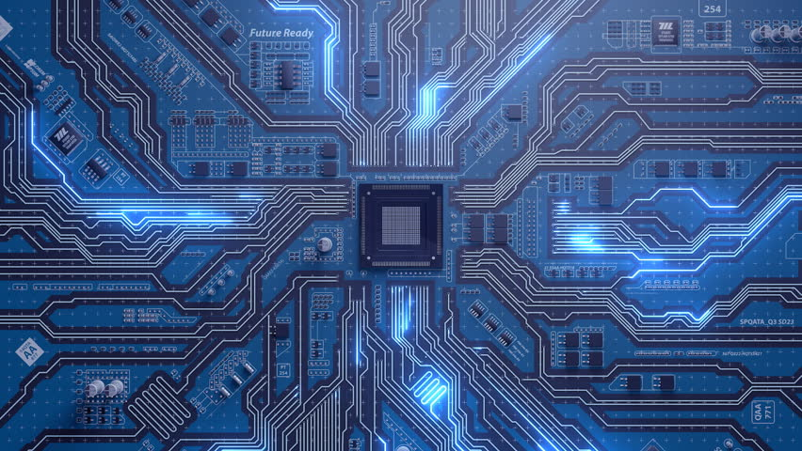

Computer-Aided Design تراشه های منطقی برنامه پذیر
Mahdi Aminian
Some slides courtesy of:
CAD slides, Dr. Saheb Zamani
allaboutcircuits.com

Slide 2
Digital Circuits
Logic
Standard
Logic
ASIC
Programmable
Logic Devices
(FPLDs)
Gate
Arrays
Cell-Based
ICs
Full Custom
ICs
SPLDs
(e.g., PALs)
CPLDs
FPGAs
Microprocessor
& RAM
Acronyms
SPLD = Simple Programmable Logic Device
PAL = Programmable Array Logic
CPLD = Complex PLD
FPGA = Field Programmable Gate Array
ASIC = Application Specific IC
Common Resources
Configurable Logic Blocks (CLB)
Memory Look-Up Table (LUT)
AND-OR planes
Simple gates
Input / Output Blocks (IOB)
Bidirectional, latches, inverters, pullup/pulldowns
Interconnect or Routing
Local, internal feedback, and global

Slide 3
FPGA

Slide 4
Field Programmable Logic Array (FPGA)
2-D array of logic blocks and flip-flops with programmable interconnections
User can configure
Intersections between the logic blocks
The function of each block
FPGAs are usually programmed after being soldered down to the circuit board, in the same way as larger CPLDs
In most larger FPGAs the configuration is volatile, and must be re-loaded into the device whenever power is applied or different functionality is required

Slide 5
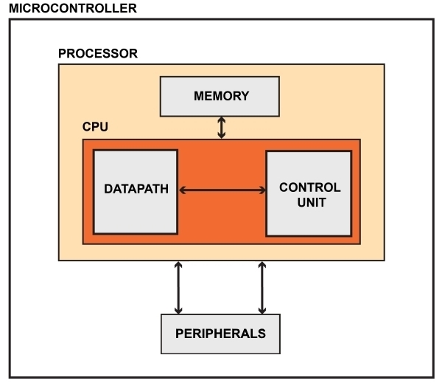
FPGA vs. MicroController

Slide 6
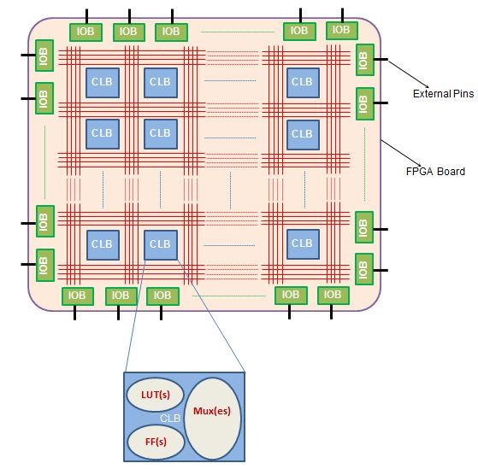
FPGA vs. MicroController

Slide 7
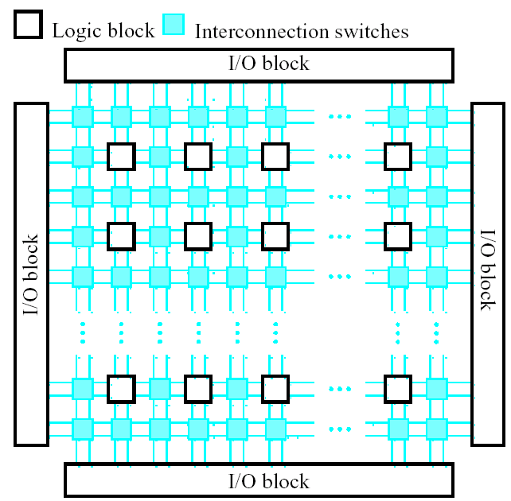
Logic Blocks (LB)
Purpose: to implement combinational and sequential logic functions.
Logic blocks can be implemented by:
Transistor pairs
Multiplexers
Look up tables( LUT)
Wide fan-in AND-OR structure.
Granularity: is the hardware abstraction level. According to granularity, two types of Blocks :
Fine Grain Logic Blocks
Coarse Grain Logic Blocks

Slide 8
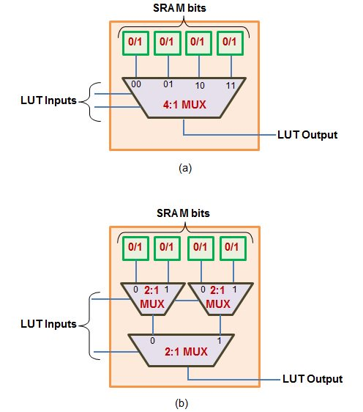
Look-Up Table (LUT)

Slide 9
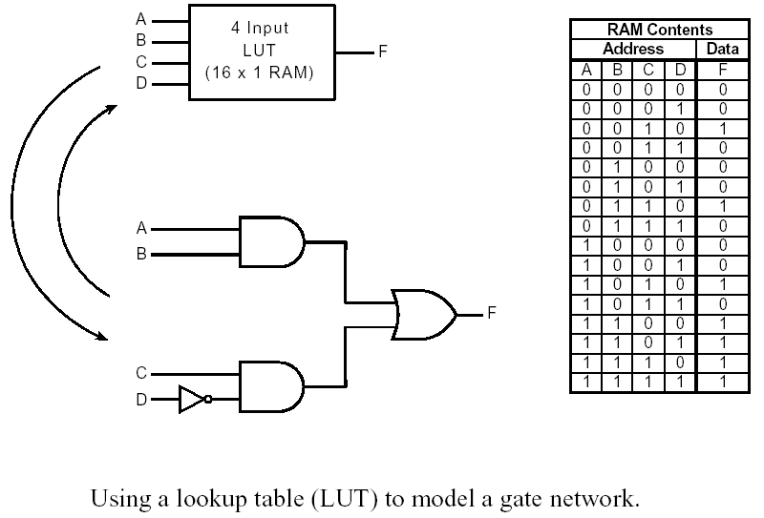
Look-Up Table (LUT)
Output of SRAM gives the logic output
k-input logic function =2^k size SRAM
K-input LUT gives 2^2^k logic functions

Slide 10
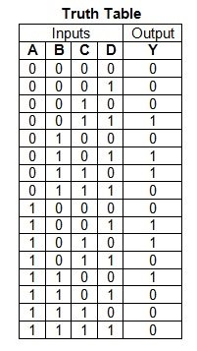
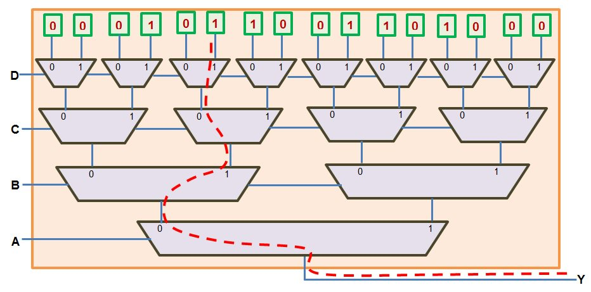
Implementation of Logic Functions using LUT

Slide 11
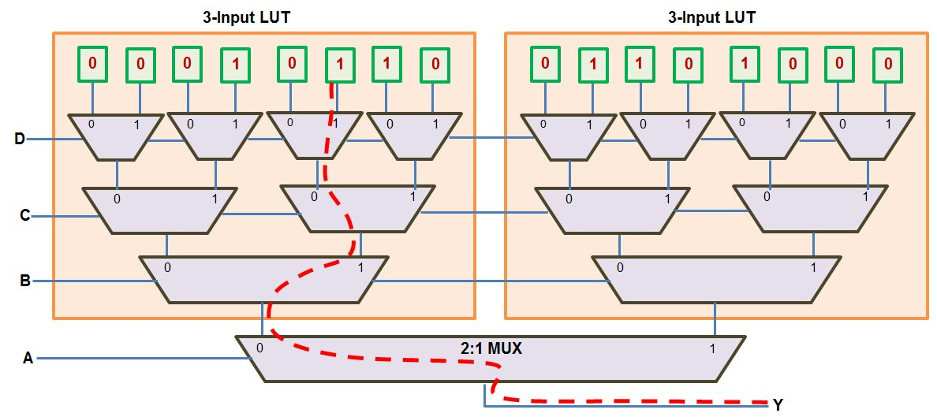
Implementation of Logic Functions using LUT-3 & MUX

Slide 12
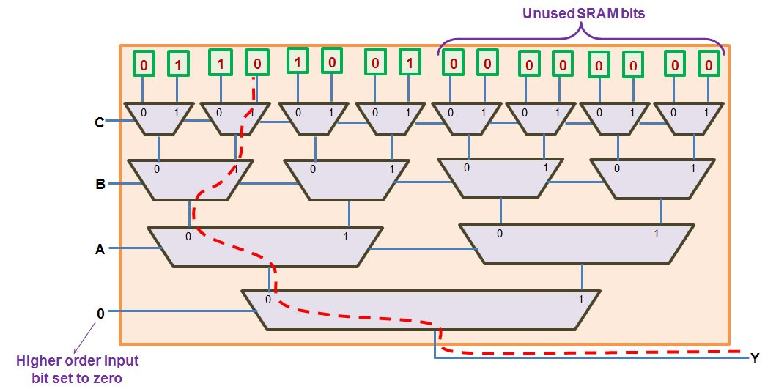
Implementation of a 3-input logic function using 4-input LUT

Slide 13
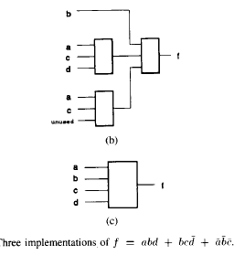
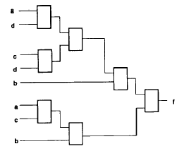
Effects of Granularity on FPGA Density and Performance
Tradeoff
Granularity increase → Blocks less
More Functional Blocks → more area
Area is normally measured by total number of bits needed to implement the design. So look the example

Slide 14
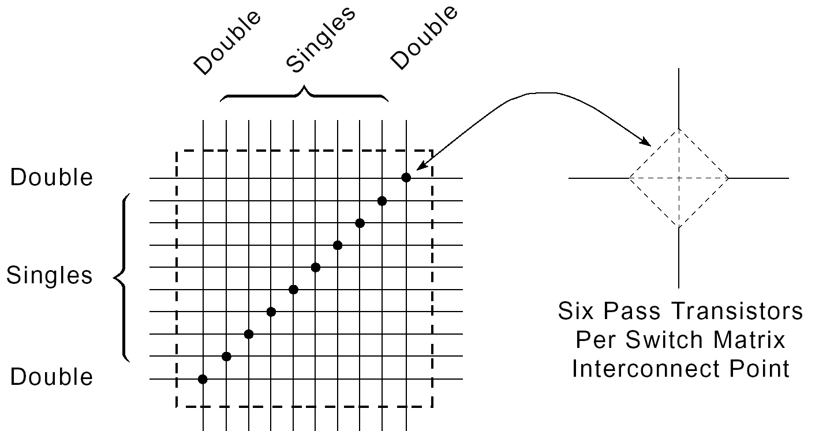
Programmable Switch Matrix (PSM)

Slide 15
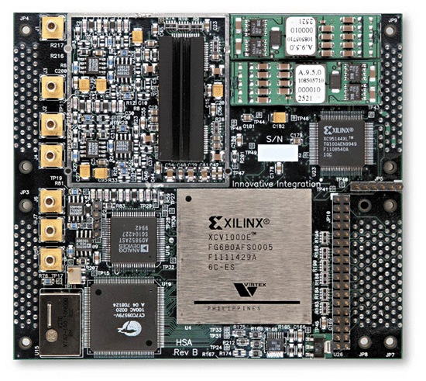
SRAM-Based FPGA
Programmable Lookup Tables (LUTs)
Programmable routing structure

Slide 16
FPGA ArchitecturE

Slide 17
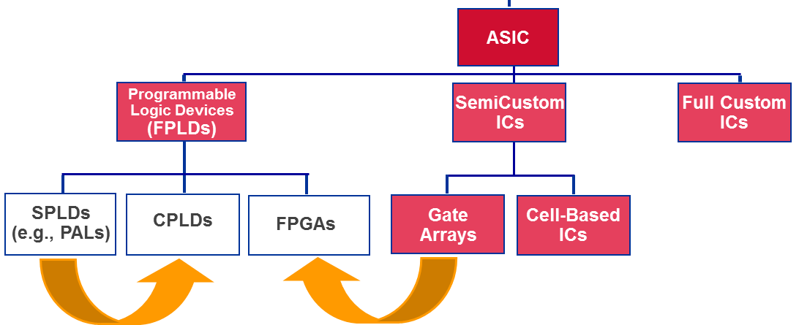
FPGA Development
FPGAs evolved from Gate Arrays
Parallel with development of CPLDs

Slide 18
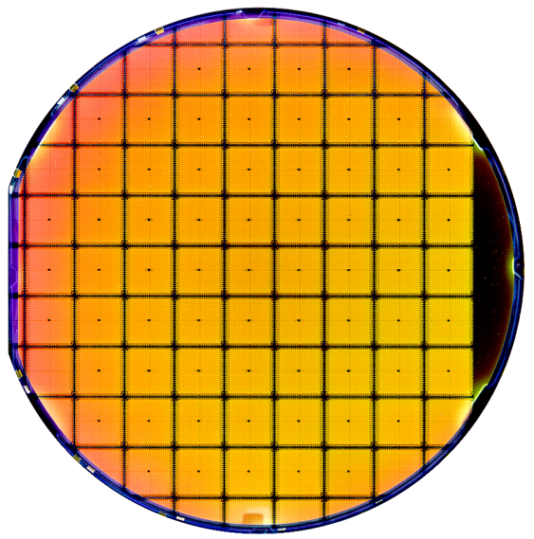
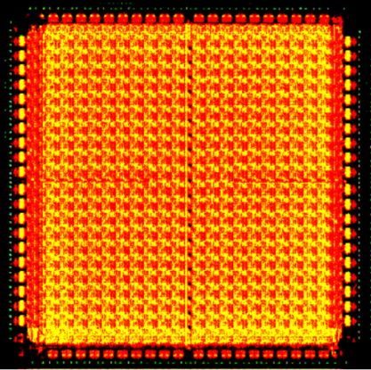
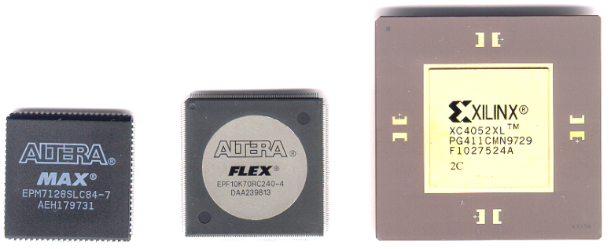
FPGA
die showing 20 by 20 array of logic elements and interconnect.
Silicon wafer containing XC4010E 10,000 gate FPGAs.

Slide 19
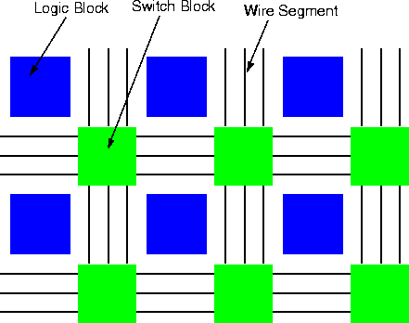
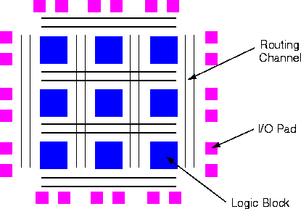
FPGA Architecture

Slide 20
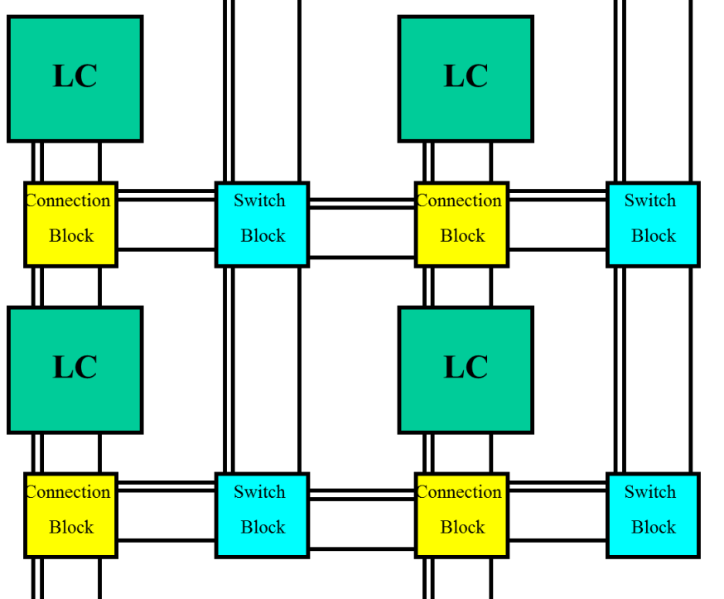
Routing Criteria
Routability
سرعت: تعداد سوييچها در مسير
فضا.
منابع اتصالي کم ← کاهش امکان پياده سازي مدار مورد نظر
منابع اتصالي زياد ← اتلاف مساحت و کاهش بخش هاي منطقي

Slide 21
Terms Definition
Wire Segment: قطعه سيمي که به يک سوييچ برنامه پذير منتهي شده است.
يک يا چند سوييچ مي تواند به يک wire segment وصل شده باشد.
Track (شيار): دنباله اي از يک يا چند wire segment در امتداد يک خط.
Channel: گروهي از Trackهاي موازي.
Connection Block: اتصال از وروديها و خروجيهاي يک LC به wire segmentهاي کانال.
Switch Block: اتصال بين wire segmentهاي افقي و عمودي.

Slide 22
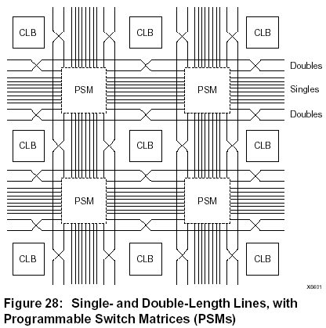
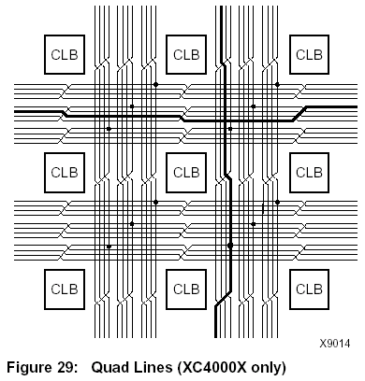
Routing Structure Example

Slide 23
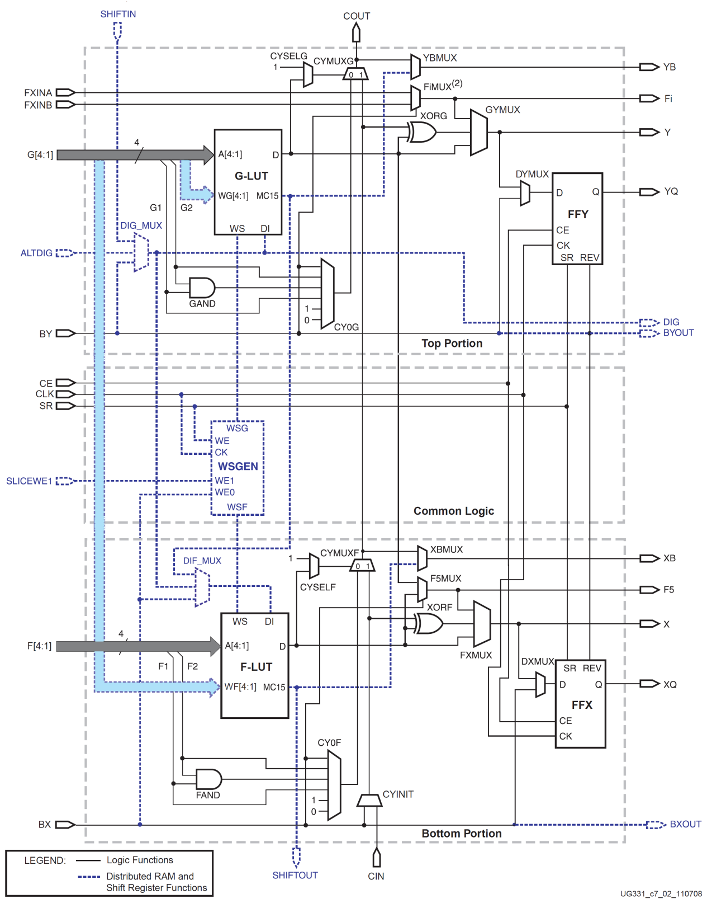
Spartan Logic Cell
Spartan Logic Cell

Slide 24
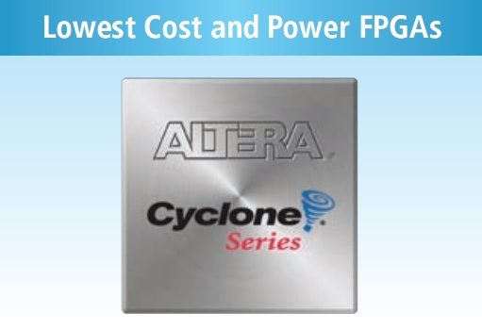
Cyclone FPGA
SRAM-based

Slide 25
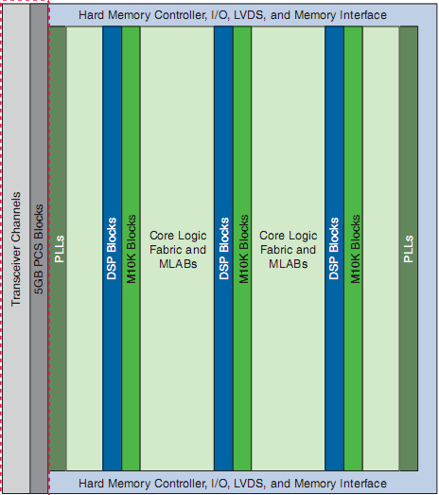
Cyclone V Architecture
Gigabit Transceiver Blocks

Slide 26
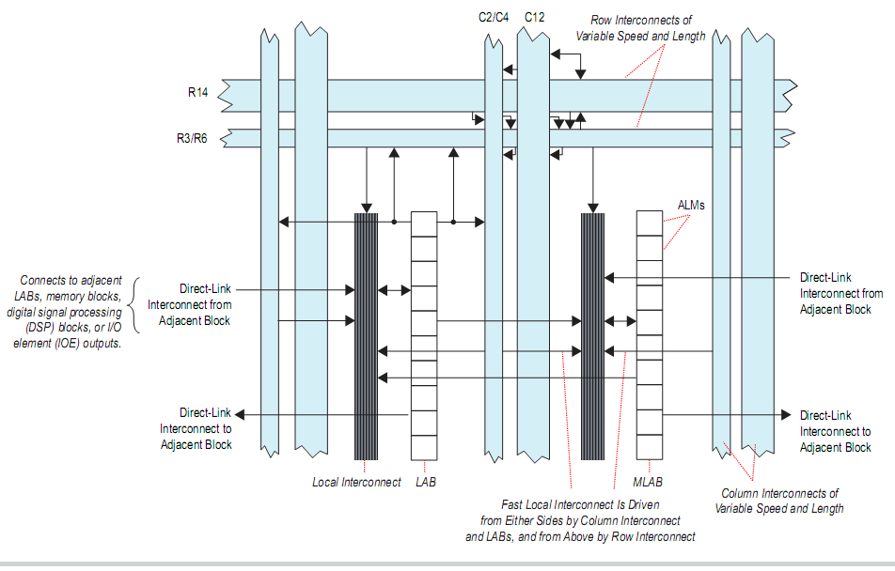
Cyclone V Architecture

Slide 27
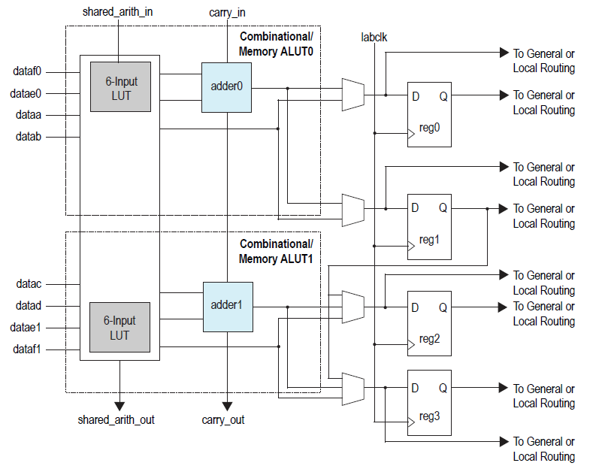
ALM Structure

Slide 28
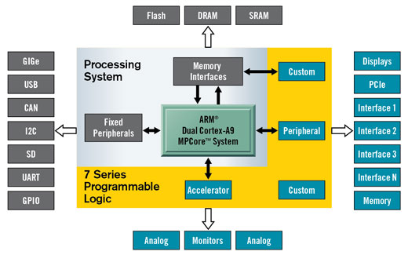
Advanced FPGA Architectures
The Xilinx Zynq-7000 AP SoC product line provides scalable performance and configuration serving a wide range of applications needs. The combination of the ARM® dual-core Cortex™-A9 MPCore™ processing system and 7 series programmable logic provides a computing platform. Zynq-7000 AP SoC is ideal for solutions requiring advanced system control combined with sophisticated signal processing.

